Slide 1
Adaboost algorithm
Ensemble ML algorithms
AdaBoost = Adaptive Boosting
Combining multiple weak models(small decision tree) to form a strong model
Improve predictions by correcting the previous errors

Slide 2
How it works?
Starts with a weak model (e.g., Decision Tree with depth=1)
Calculates prediction error
Adjusts weights → gives more focus to hard-to-predict data
Repeats this for multiple models (boosting)
Final prediction = weighted average of all models

Slide 3
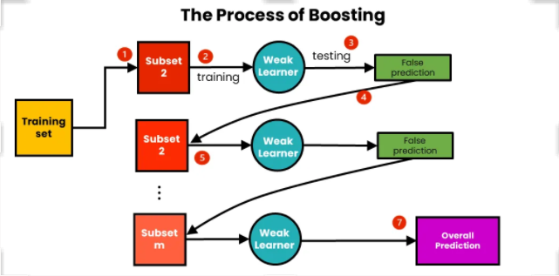
Process

Slide 4
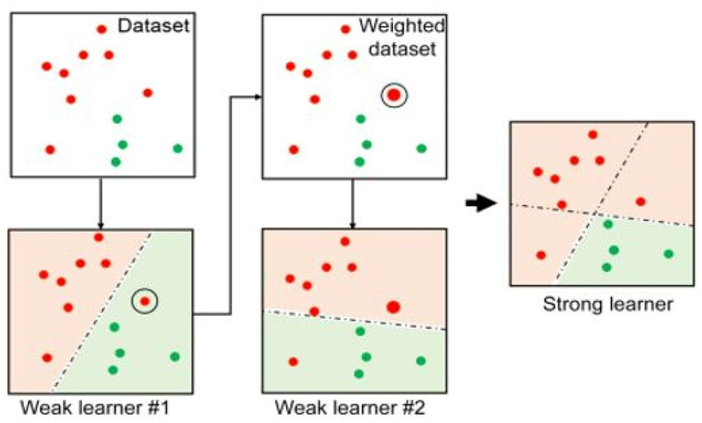

Slide 5
Why Adaboost?
Captures non-linear patterns
Improves over simple models
Performs well with small to medium datasets
Can reach high accuracy with proper tuning

Slide 6
Disadvantages
Slower training on large datasets
Requires clean, fully preprocessed data
Easily confused by incorrect or unusual data
Struggles with imbalanced datasets
Performs best with simple models and overfits with complex ones
Less accurate compared to XGBoost and LGBoost algorithms

